Slide 1
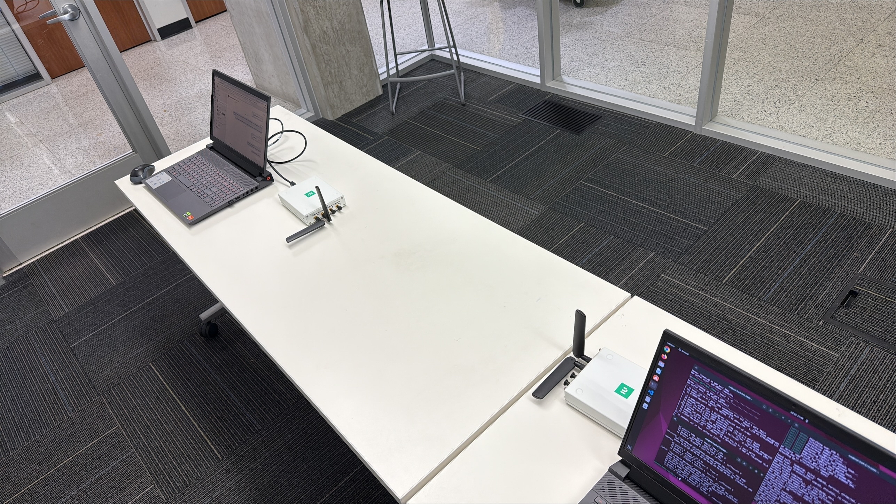
srsUE
srsenb

Slide 2
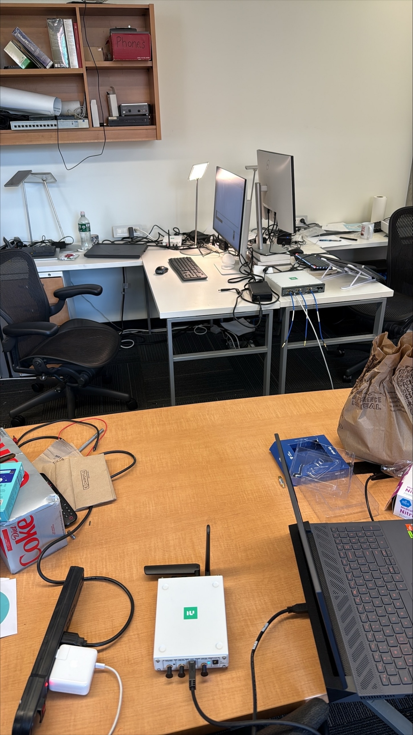
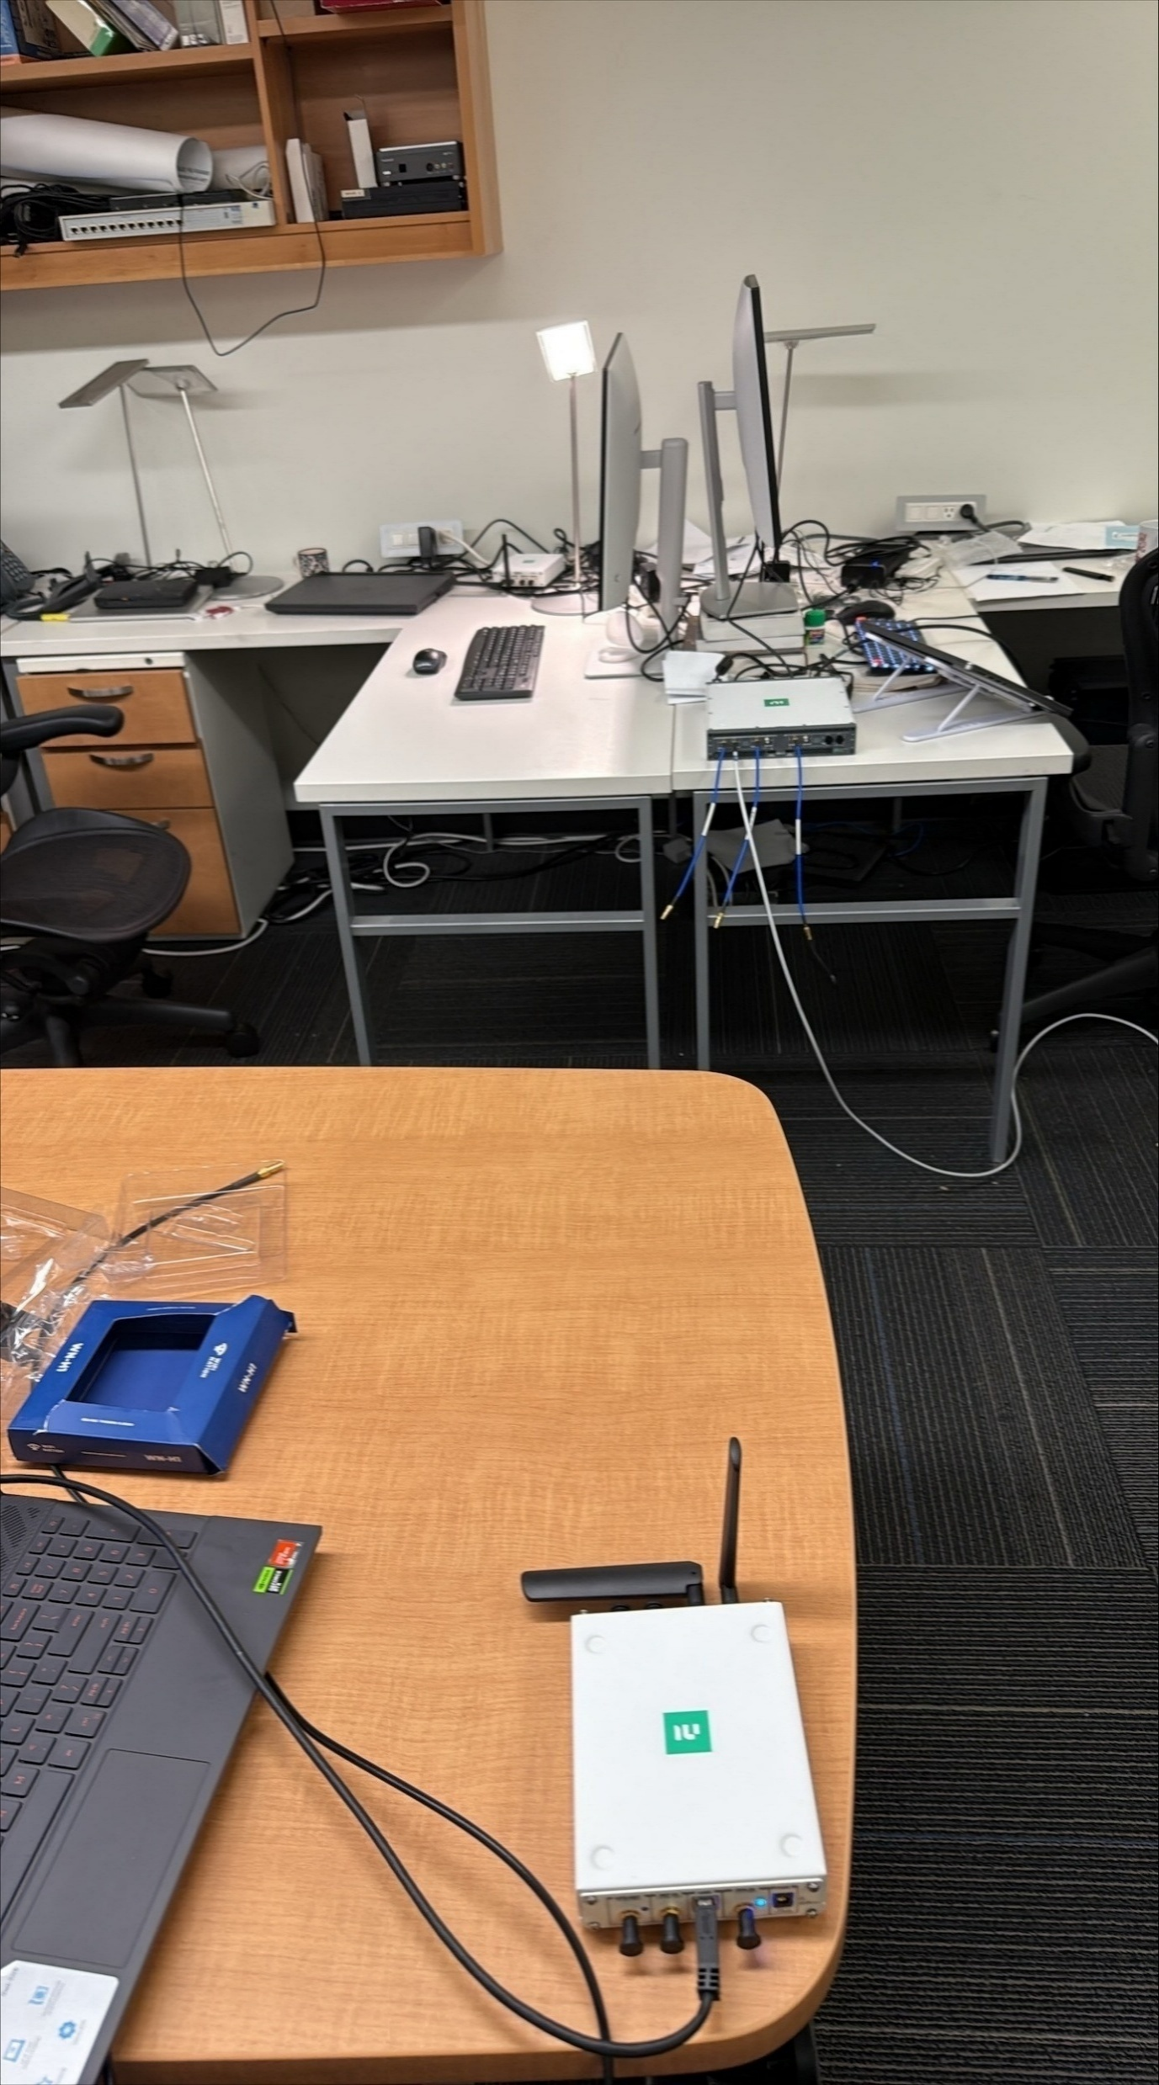
POS1
POS2
srsenb
srsenb
srsUE
srsUE

Slide 4
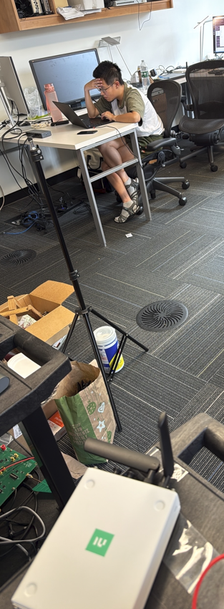
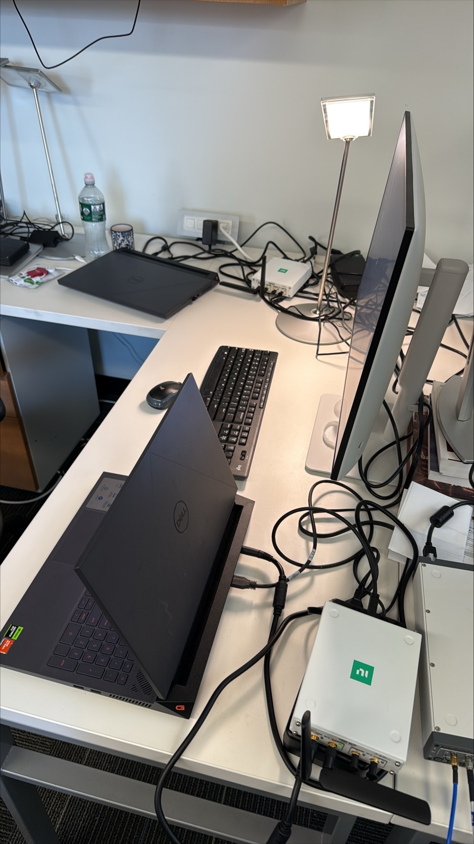
srsenb
POS2
srsenb
POS1
srsUE
srsUE

Slide 5



Represent impenetrable surfaces that partially obstruct the propagation path
Represent obstacles partially blocked the signal
Desk 1
POS1
POS2
srsenb
srsenb
POS2
srsenb
srsenb
srsenb
POS1
srsUE 4
NLOS POS1
NLOS POS2
Desk 3
srsUE
srsUE
srsUE
srsUE
Desk 2
srsUE 3
srsUE 1
srsUE 2
LOS (Moderate Multipath)
POS1
POS2
(a) Floor plan of the other indoor test environment.
(b) Indoor NLOS.
(c) Indoor LOS (Moderate Multipath).

Slide 6
Represent impenetrable surfaces that partially obstruct the propagation path
Represent obstacles partially blocked the signal
POS1
POS2
Desk 1
srsenb
srsENB
srsENB
srsUE 2
srsUE
NLOS POS1
NLOS POS2
Desk 3
srsUE 1
srsUE 2
srsENB
srsUE 1
(a) Floor plan of the other indoor test environment.
(b) Indoor NLOS.
(c) Indoor LOS (Clean).

Slide 7
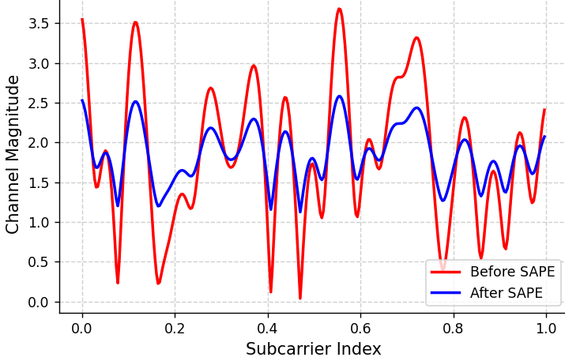
Deep fading introduced high error rate

